Slide 1
Government Propaganda
World War One

Slide 2
“Propaganda”
information, especially of a biased or misleading nature, used to promote or publicize a particular political cause or point of view.
(Wikipedia)

Slide 3
Another definition
information, ideas, or rumors deliberately spread widely to help or harm a person, group, movement,
institution, nation, etc.
(Dictionary.com)

Slide 4
Instructions
For each WWI propaganda poster, determine
What is the message?
What images/ideas are used for persuasion in each poster?

Slide 6
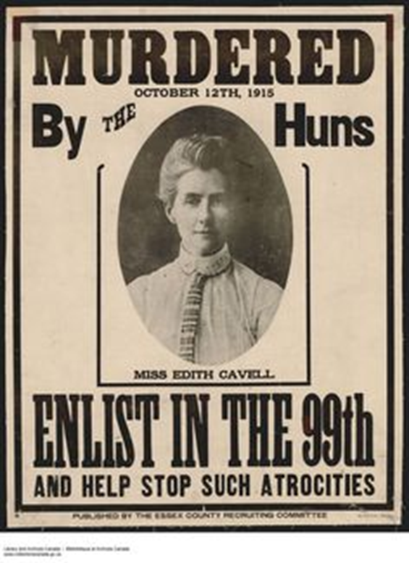
Edith Cavell – a British nurse who saved the lives of soldiers on both sides, and who was executed for treason by a German firing squad in 1915
“Hun” – a derogatory slang term for a German soldier

